Slide 1


Slide 2
Project 1a: Hard and Calm:
No changes were made to the Hard and Calm Design, due to the lack of suggestions
Project 1b: Soft and Dynamic:
In this project the design was redone. I added white drums to the bottom and added black circles to create depth . The addition of the blacks circles, I believe makes the other items jump off the page.

Slide 3

Project 1a: Hard and Calm

Slide 4

Project 1b: Soft and Dynamic

Slide 5
Peaceful:
No addtions or changes to this design
Sad:
No additions to this design

Slide 6

Peaceful

Slide 7

Sad

Slide 8
Project 3a: Children's eBook Cover:
Completely redid project. The appearence lacked the desired feeling. Different graphics were used and a different title font (Keep on Trucking)
Project 3b: Corporate Law Firm Business Card:
Completely redid project. The submitted project for discussion lacked clarity, in the graphicand felt plain. Employed color and contrasting black boarder on left margin

Slide 9

Project 3a: Children's eBook Cover

Slide 10

Project 3b: Corporate Law Firm Business Card

Slide 11
Free Form Design:
Completely redone from top to bottom. Wanted something that had character but also was clear and would draw the reader's attention.
Grid Design:
Added an underline to the tag-line. Increased font size for the business name and corrected spelling errors.

Slide 12
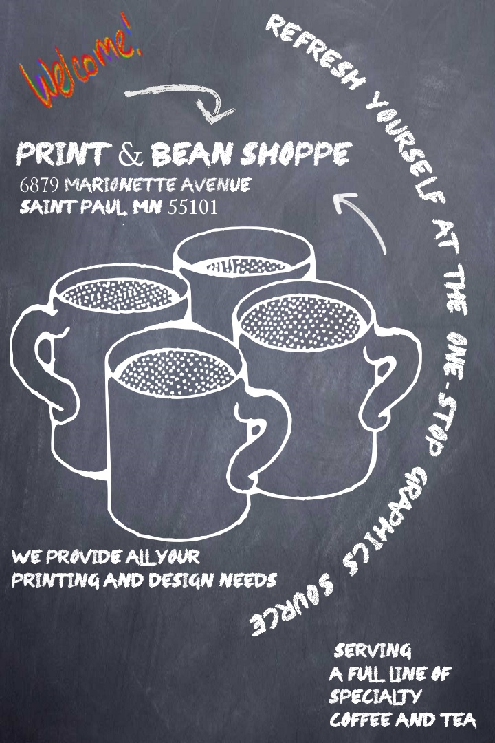
Free Form Design

Slide 13
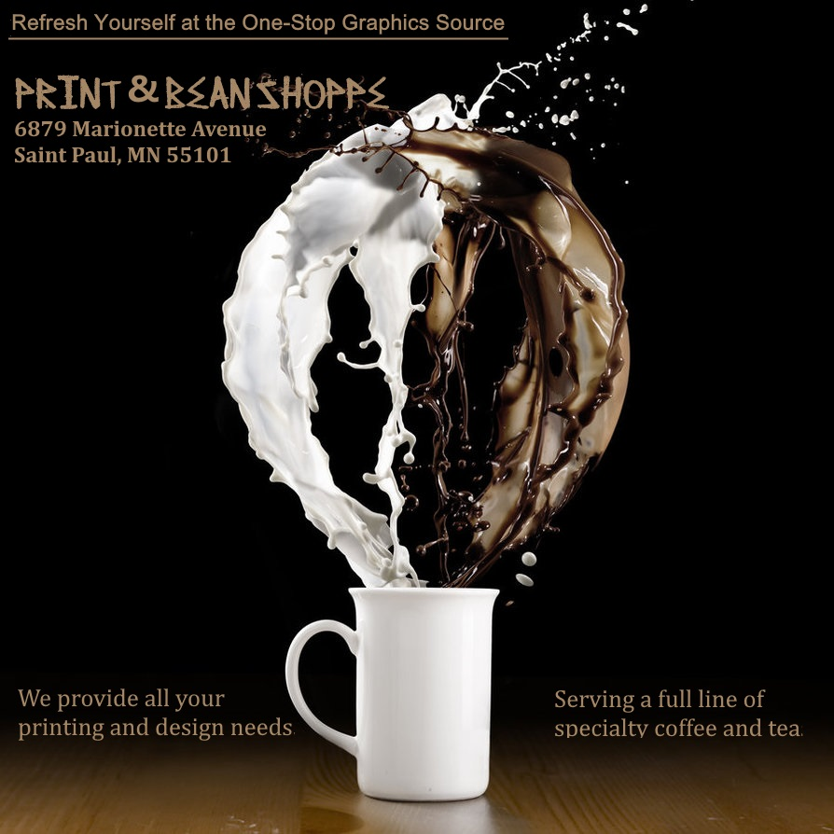
Grid Layout revised

